Slide 1
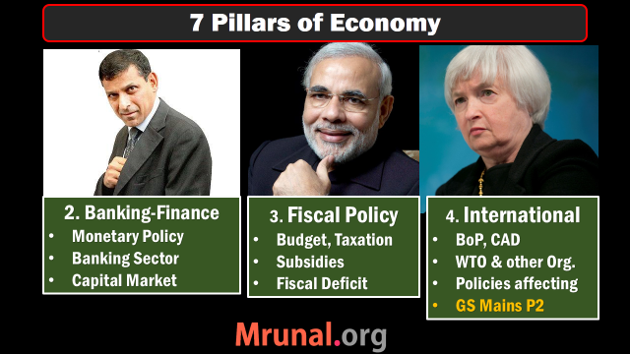
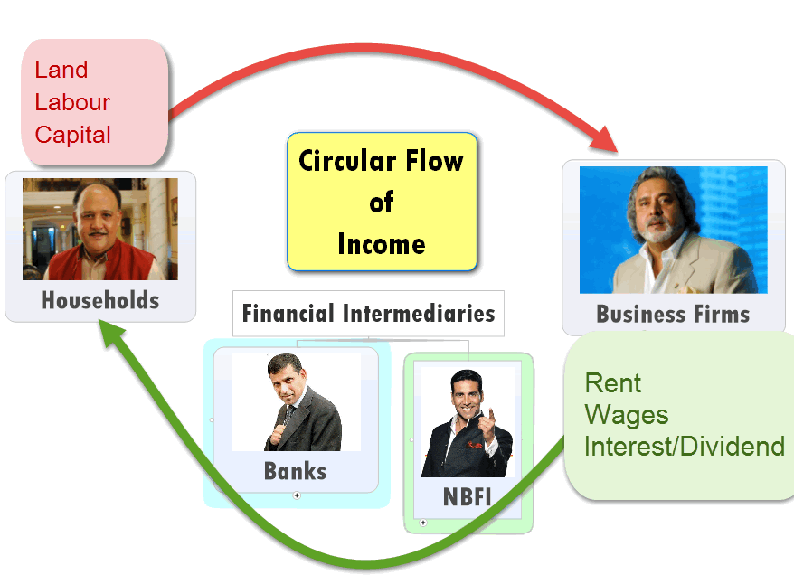
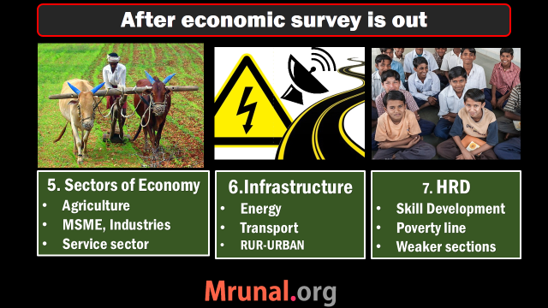
#1: NCERT

Slide 2

All clients can borrow short term loans from RBI @this interest rate. can’t use SLR securities though!
Have to set aside this much cash in reserve
=no income
Long term loan from RBI
Bank Rate 8.75
MSF
8.75
Repo 7.75
RR 6.75
SLR 21.5
CRR 4%
NDTL
Only for Sch. Commercial banks can borrow from RBI @this Interest rate. Can even use SLR securities
What RBI pays to its clients for short term loans
Banks have to keep this much in cash, gold, G-sec & other RBI approved securities

Slide 3
Monetary Policy
Quant. Tool | Inflation fight Tight/Dear | Deflation fight Easy/Cheap
CRR, SLR | Increase | Decrease
OMO | Sell | Buy
Policy RATE | Increase | Decrease

Slide 4

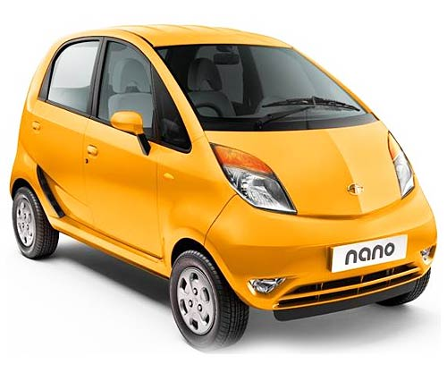

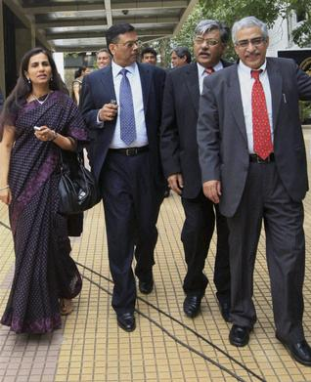

Qualitative /selective/ direct Tools

Slide 5
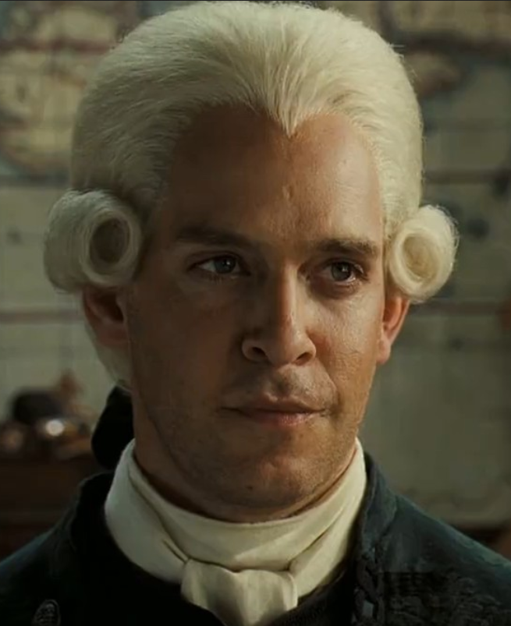
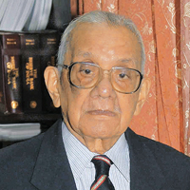


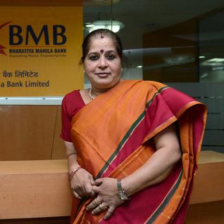

Evolution & financial inclusion

Slide 6
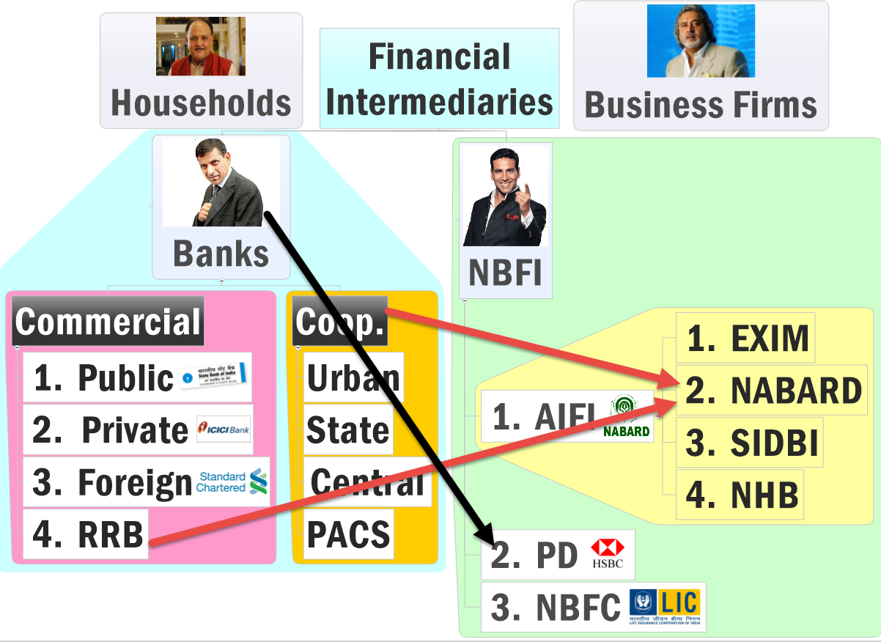

Slide 7
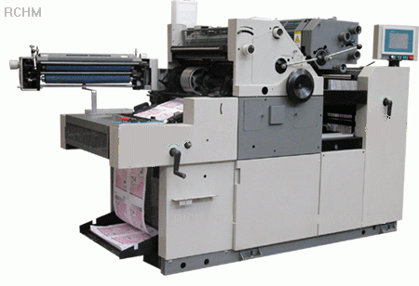
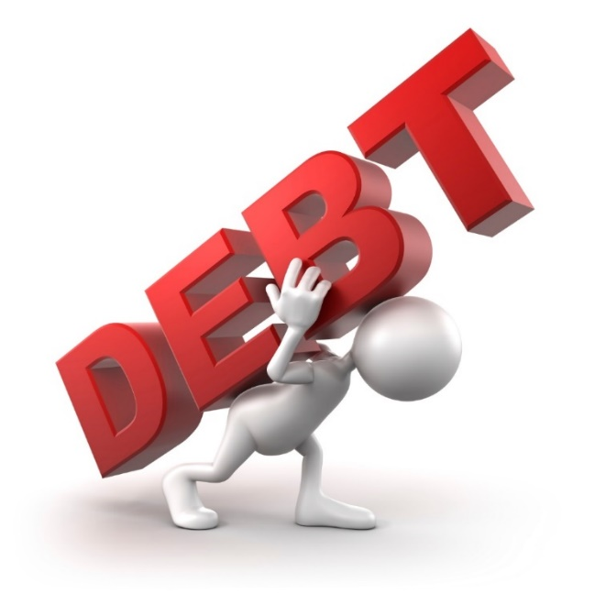
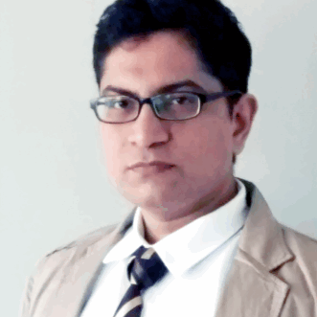

Rs.10 lakh
Equity: Shareholders
Proprietors
Creditors
20%
80%
5 lakh
1 lakh
4 lakh

Slide 8
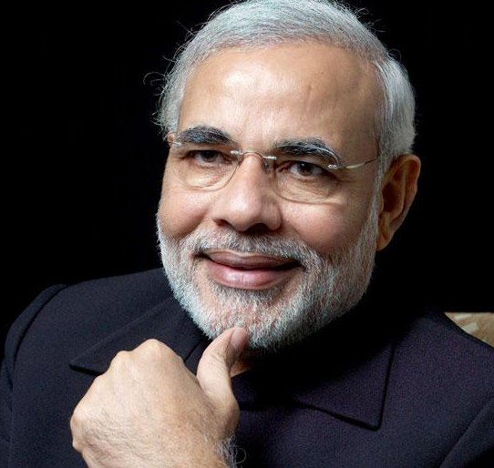
Financial Market
Money Market
Capital Market
Primary
Secondary
Short term
Long term
T-Bill
G-Sec

Slide 9

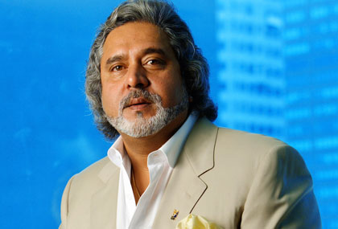

Shares
ADR
Dividend
$$
NASDAQ

Slide 10


ETF: Exchange Traded Fund
ONGC, CIL, GAIL
10 CPSE
Rs.3000 crore
NFO
Rs.10
Rs.10
Rs.20
Rs.10
Portfolio Goldman Sach
BSE-NSE
Notes:
NAV fluctuates daily

Slide 11
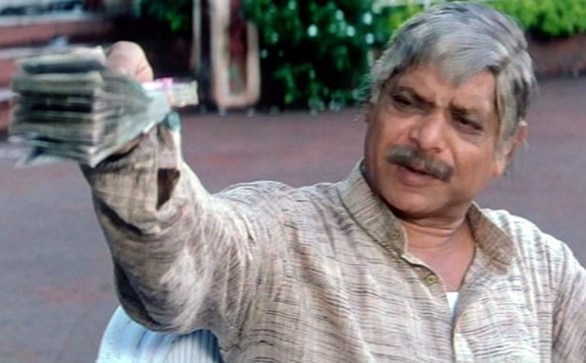









Hawala operator sends Rupees to Tax Haven, converting
to Dollars
Sadhu Yadav a.k.a Politician, builder, Contractor & Mafia
all in one Multiskill
Hedge Fund Manager or Investment banker
in Tax Haven
SEBI registered FII
P-Note
Derives value from FII’s portfolio
FII’s portfolio

Slide 12

SENSEX calculation: 1979
70k with public
30k with Mallya

Slide 13
Demat System
Your DEMAT account
Your Paper Shares
Depository
CSDL
NSDL
Dep.
Participant
SBI
HDFC
ICICI
Customer
You
Financial inclusion
#PAN
#DEMAT
Notes:
Securities depository ltd.

Slide 14
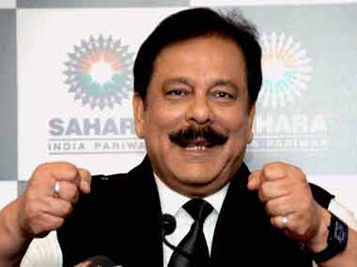
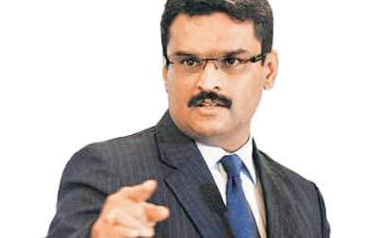
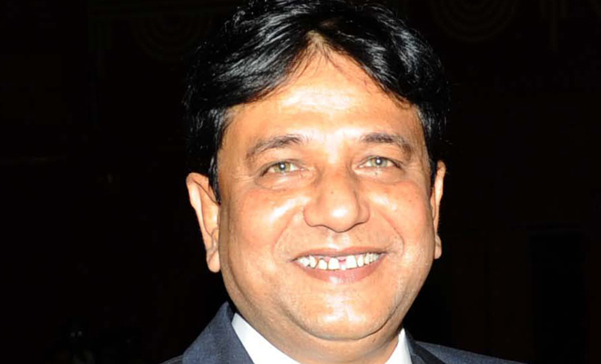
Sahara
NSEL
Saradha
Financial Scams in Recent years
Modus Operandi Ph.D …Only Basic idea
How to prevent- FSLRC….Important

Slide 15
#1: NCERT
Major topics
Covered
New topic

Slide 16

Balance of Payment International Trade
Definition
Components

Slide 17
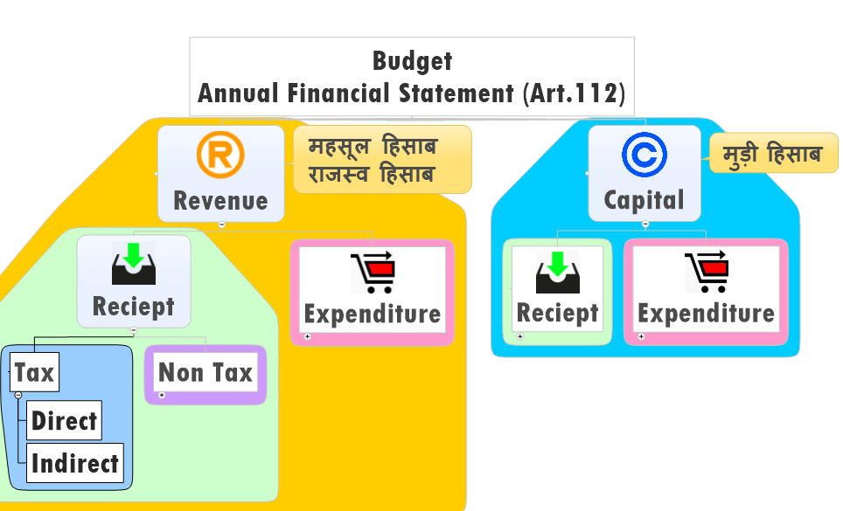

Slide 18
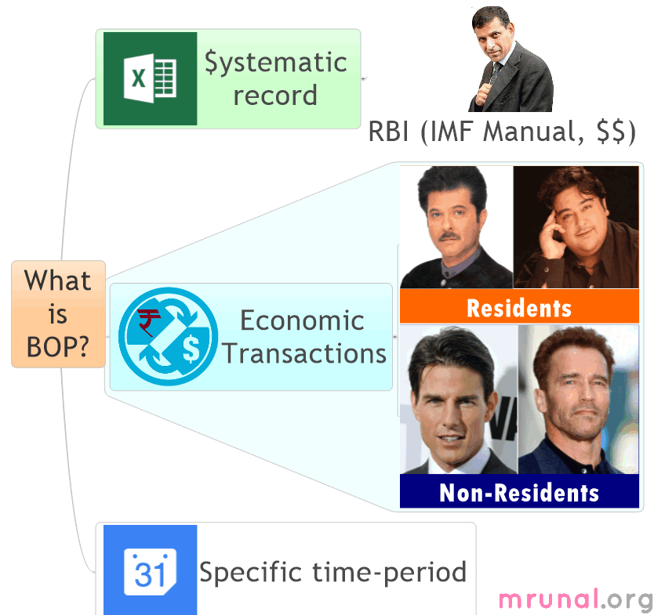
Notes:
Sami song

Slide 19

System Record
BoP
Maintained by Central bank of each country
As per IMF manual “BMP6”
All amounts Expressed in Dollar$$
Credit: Incoming money (+)
Debit: Outgoing money (-)
Sample Click me
Notes:
Debit: outgoing
Credit: incoming

Slide 20
Notes:
Sami song

Slide 21
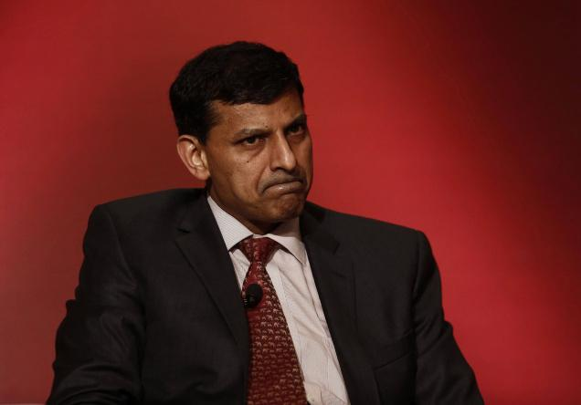
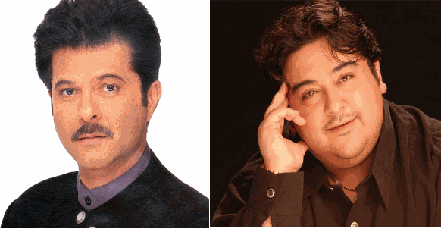


Economic Transactions
Anil to Adnan?
No because both ‘residents’.

Slide 22


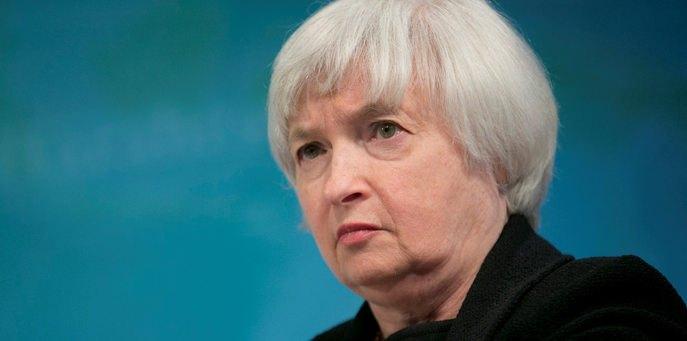
Economic Transactions
Tom Cruise to Adnan Sami?
Yes…because resident vs non-resident
US Fed Reserve: outgoing (-)
Indian RBI: incoming (+)

Slide 23


Economic Transactions
Adnan to Parents in Pakistan?
Yes
Indian RBI: outgoing (-)
Pak Central Bank: incoming (+)
Canadian Centre Bank…. (NA)

Slide 24
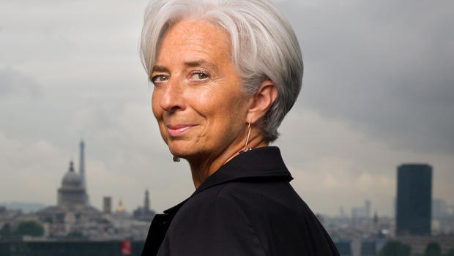

World’s Balance of Payment
=ZERO

Slide 25
Notes:
Sami song

Slide 26
Balance of Payment International Trade
Definition
Components

Slide 27
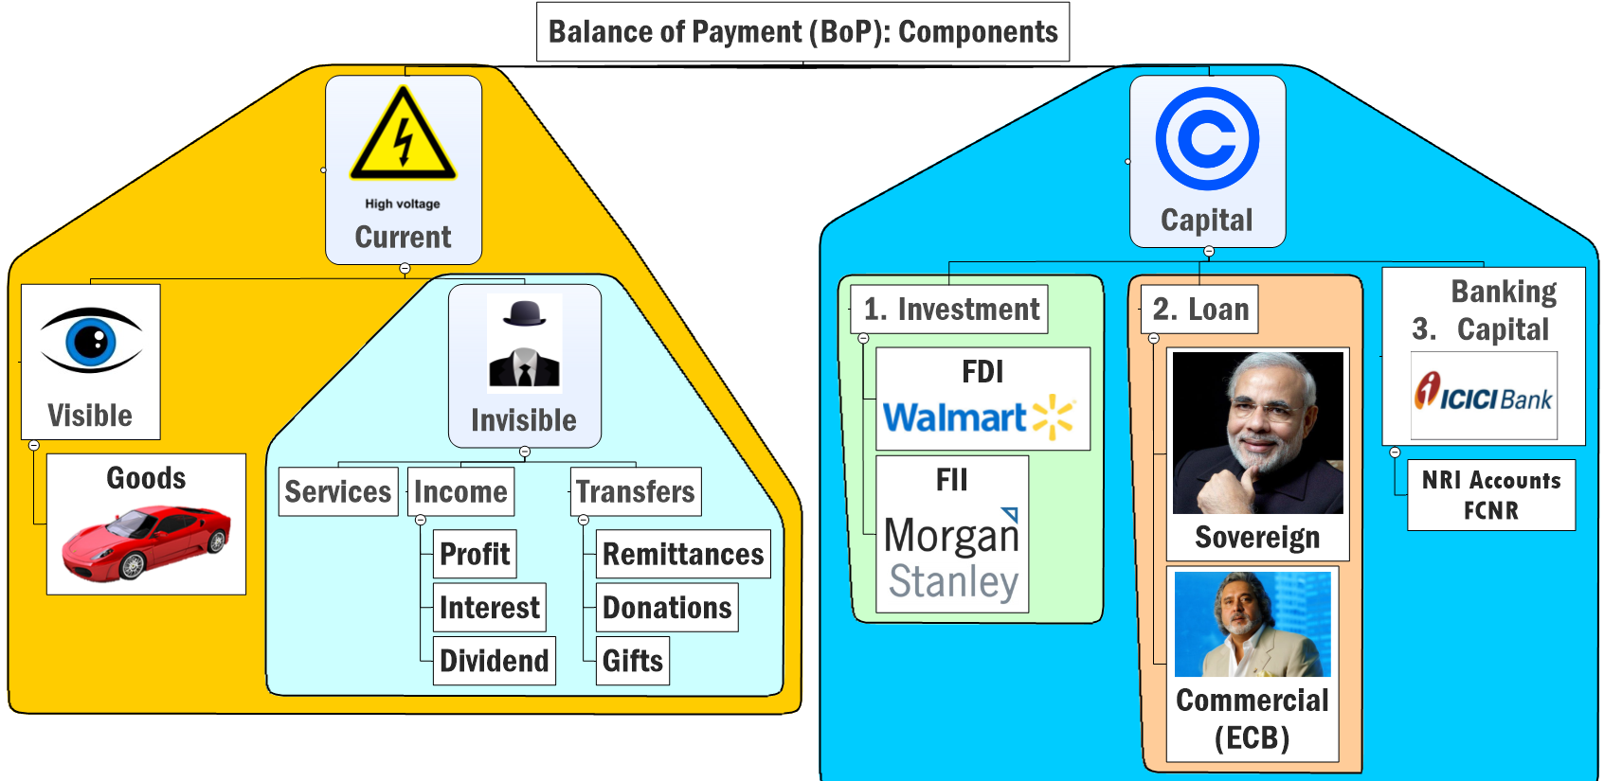

Slide 30
BoP: Current Account (2013-14) Million USD
Component | + Credit (Incoming) | Debit (Outgoing) | Net
Visible =>Goods | (Export) 3 lakh | (Import) - 5 lakh | MINUS 2 lakh

Slide 31
Balance of Trade =Net difference between Imports & Exports
Trade Deficit = When BoT is negative. (IM > EX)
Trade Surplus = BoT Positive (EX > IM)

Slide 32








Main Imports
Main Exports

Slide 33

For Ranking refer to Ch.6 of Economic Survey
TRADE
Deficit

Slide 34
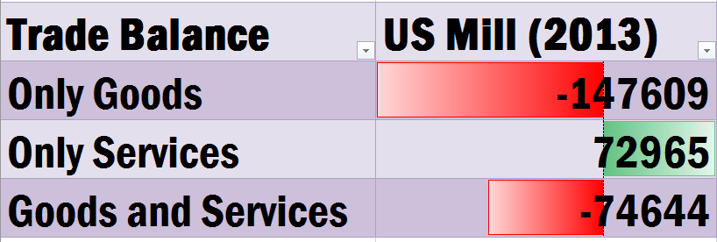
Balance of Trade

Slide 35
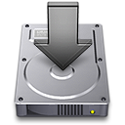


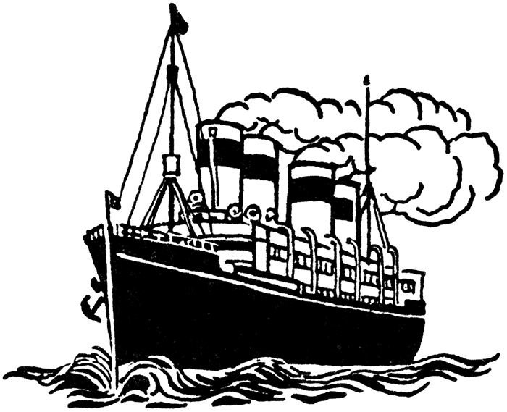
Deficit
surplus

Slide 36

CEO/MD, Executives, Staff
Board of Directors, Chairman
Capital Account (+)
Current Account
Profit, interest dividend (-)
Foreign investor: debt / Equity
Notes:
Kishor Biyani, Future group, Pantaloon

Slide 37
CEO/MD, Executives, Staff
Capital Account (+)
Board of Directors, Chairman
Shares sold money taken out
Capital (-)
Foreign investor: debt / Equity
Notes:
Kishor Biyani, Future group, Pantaloon

Slide 38
CEO/MD, Executives, Staff
Capital Account (+)
Board of Directors, Chairman
Bond/Debenture
Principal repaid
Capital (-)
Foreign investor: debt / Equity
Notes:
Kishor Biyani, Future group, Pantaloon

Slide 39
Profit-interest-Dividends
surplus
Deficit
Deficit

Slide 40
DEFICIT
Remittances 2013 (World Bank) | Billion
India | 70
China | 60
Philippines | 25
Mexico | 22
Nigeria | 21
SURPLUS
DEFICIT
SURPLUS
Current Account Balance

Slide 41
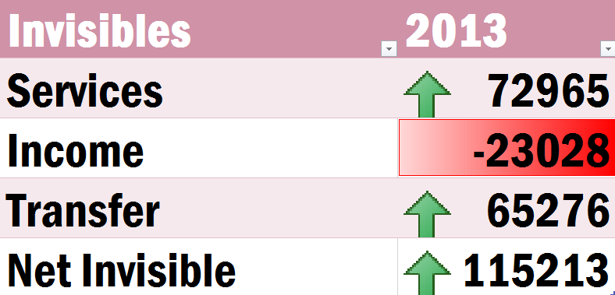

Slide 42
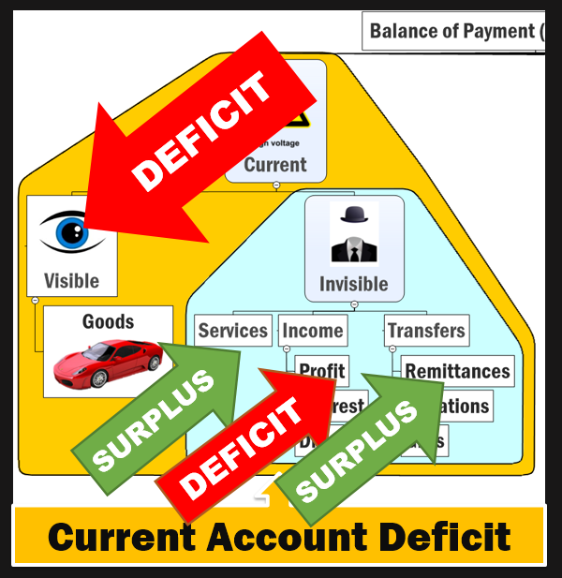

Visible vs Invisible
CAD
Visible: -147 billion
Invisible: +115 billion
Balance: (-) 32 billion
Hence “Current Account” Deficit

Slide 43
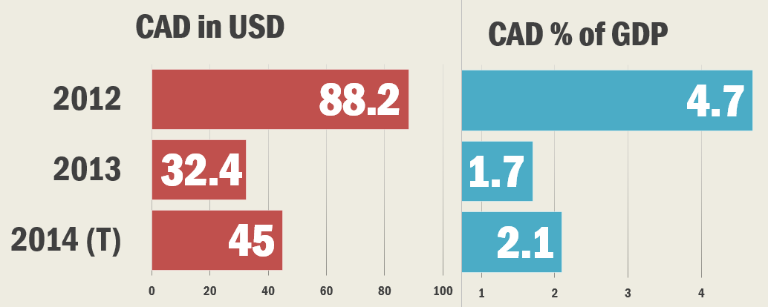
India’s CAD: Past Present Future

Slide 44
How to reduce CAD?
Crude oil consumption reduce? Not possible beyond a point.
Gold ban? Smuggling; reduce inflation; +ve Real interest rate
IT boost? Alone insufficient
Agro + Mfg. + service: boost
FDI promote? Capital PLUS but Current MINUS

Slide 45

Current Account Deficit
Capital Account

Slide 46
Capital Account
Difference between FDI and FPI (FII)

Slide 47
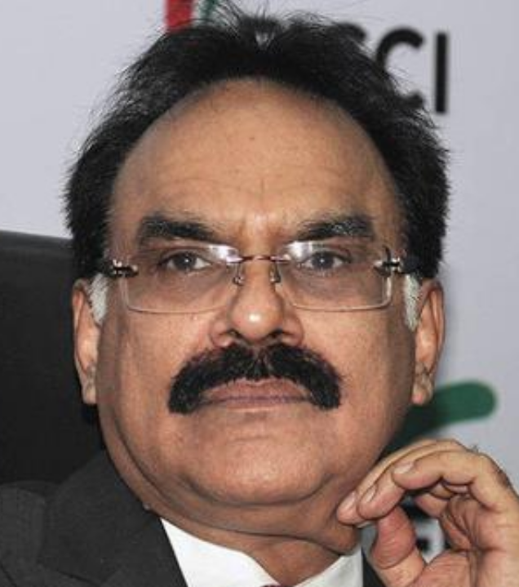
Arvind Mayaram Panel
FDI-FII
By finance ministry
to bring clarity on definition of FDI and FII
Recommendations accepted in June 2014

Slide 48
Types of companies: Mayaram FII
Companies Act
2013
Public Ltd.
7-unlimited
Listed
Vodafone India.
Unlisted
Nokia India
One person
Private ltd.
2-200
10% or more FDI
<10: FPI (FII)
Any investment FDI

Slide 49
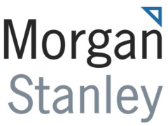


FDI
FII / FPI
Long-term relation with company & its board
Anonymous
Short-term

Slide 50
FDI
FII / FPI
Listed: 10% or more
Unlisted: any investment is FDI
Any Public ltd. company: below 10%

Slide 51
FDI
FII / FPI
Sectoral cap: 49% insurance; 74% in private banks
If public listed then anyone can purchase below 10%

Slide 52
FDI
FII / FPI
Only one category “FDI”
Earlier sub-categories: FII, QFI
SEBI: FPI
RBI: ReFPI

Slide 53
FDI
FII / FPI
NRI- further deliberation, said Mayaram
NRI investment not counted

Slide 54
FDI
FII / FPI
FDI applies to Equity finance only.
Debenture…No
Fully convertible debenture…yes
G-Sec / T-Bill: NO (Debt instruments)
Both debt and equity
But can’t buy T-Bill
G-Sec: 30 billion
Corporate bonds: 51 billion

Slide 55
FDI
FII / FPI
RBI (FEMA)
FIPB
Companies required to disclose
Individual: SEBI
Aggregate: RBI
Companies required to disclose

Slide 56
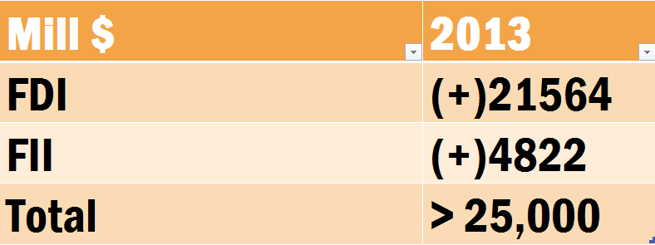
Capital Account: Foreign investment

Slide 57
SURPLUS
SURPLUS
SURPLUS
Current Account Deficit

Slide 58
Capital Account inflow
Most stable
Most volatile
FDI
External assistance (Soft loans)
ECB
FII (FPI)
FCNR Foreign Currency Non-Resident accounts

Slide 59
Current Account deficit
Capital Account surplus

Slide 60
MCQ 2013: find components of capital account?
Foreign loans
Foreign direct investment
private remittances
portfolio investment
Answer choices
123
124
234
134

Slide 61
Short | Long
Goes back.
Short term,
Doesn’t go back

Slide 62
MCQ 2013: Capital account components
Foreign loans
foreign direct investment
private remittances
portfolio investment
Answer choices
123
124
234
134

Slide 63
BoP definition
Components of Current Account and Capital Account
Next: Balance of Payment CRISIS

Slide 64
Current Account DEFICIT
Capital Account SURPLUS

Slide 65
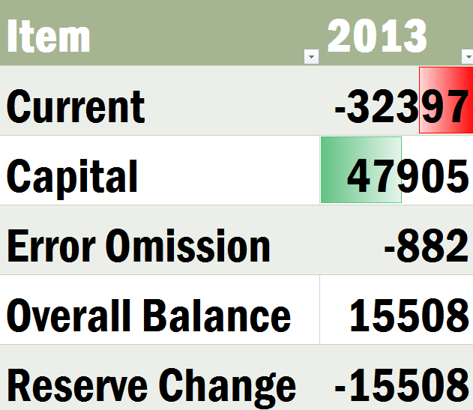
Balance of Payment India (Mill.USD)

Slide 66
Balance of Payment India (Mill.USD)

Slide 67
Balance of Payment India (Mill.USD)

Slide 68
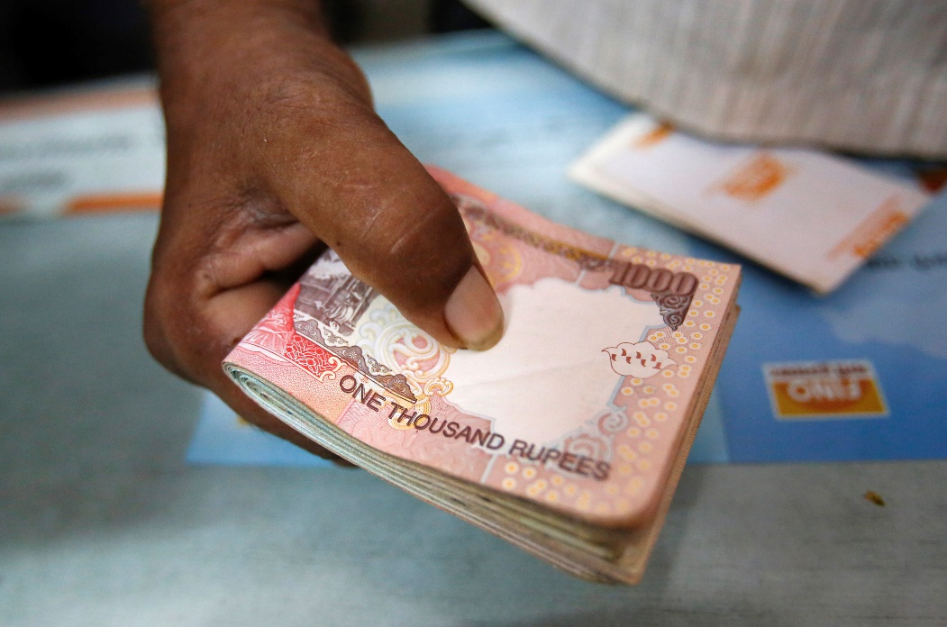
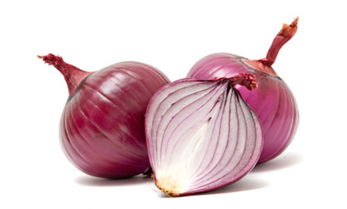
Supply Demand
1 kg = Rs.100
Supply
Demand

Slide 69




Inflation
Demand
Demand
1 kg = Rs.1000
Supply
Demand
Demand

Slide 70
Reduce demand by ▼ money supply
Demand
Demand
1 kg = Rs.100
Supply
Demand
Demand

Slide 71

If Balance of Payment is POSITIVE
$1=50Rs.
$1=40Rs.
Bad for Indian exporters

Slide 72
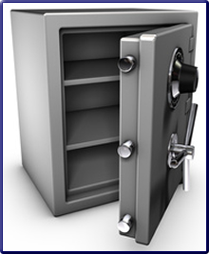
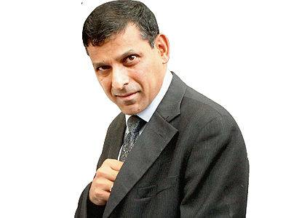
If BoP surplus- RBI should purchase those $$ (Mill.USD)
Balance of Payment ZERO

Slide 73
Why BoP crisis in 1991-92?
1991 (Apr-Sep) | Million $$
Current | -6634
Capital | 4808
Overall Balance | -1826
Oil Import?
Gulf war, USSR

Slide 74
If Balance of Payment is Negative
$1=50Rs.
$1=90Rs.
Bad for
Indian importers

Slide 75
If BoP negative RBI should sell its own $$ (Mill.USD)
1991 (Apr-Sep) | Million $$
Current | -6634
Capital | 4808
Overall Balance | -1826
RBI's Forex Reserve | 728
RBI doesn’t have enough $$ to make BoP zero

Slide 76
Why BoP crisis in 1991-92?
1991 (Apr-Sep) | Million $$
Current | -6634
Capital | 4808
Overall Balance | -1826
IMF loan | +2300
GOLD pledge
65 tonnes

Slide 77
Moral of the story: how to face BoP crisis?
BoP crisis when capital account surplus are insufficient to finance current account deficit
Great depreciation of currency.
CAD should be kept low (OR Positive)
Capital surplus large (attract investment, LPG reforms)
Central Bank must have large-FOREX reserve

Slide 78

Forex Reserve
Components
Ranking (March 2014)

Slide 79
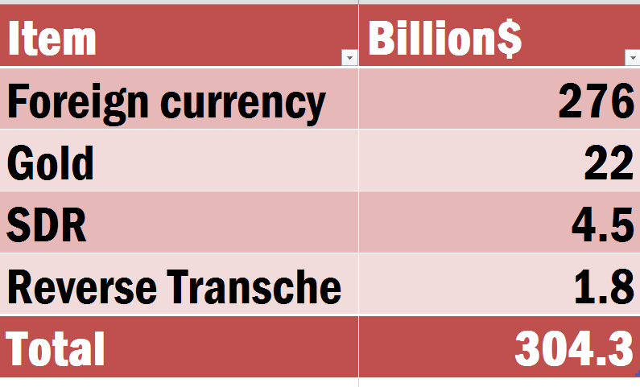
India’s Forex Reserve (March 2014)
Notes:
A certain proportion of a member country's quota is specified as its reserve tranche. The member country can access its reserve tranche funds at its discretion, and is not under an immediate obligation to repay those funds to the IMF. Member nation reserve tranches are typically 25% of the member's quota.

Slide 80
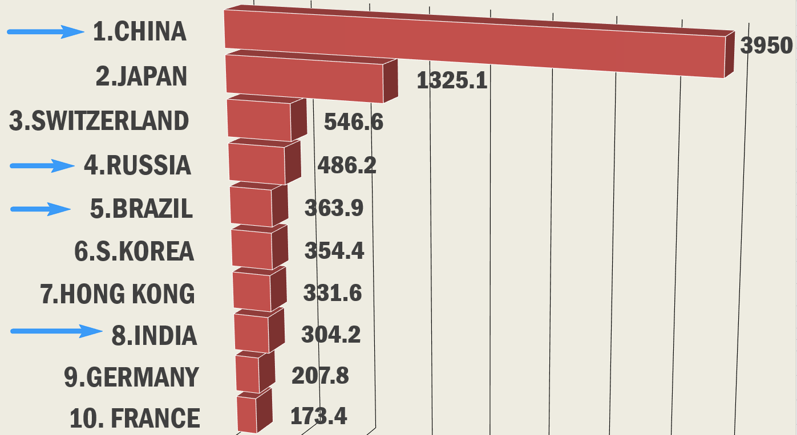
Forex Reserve
Top-10
Countries
Of the World
[old data]

Slide 81
MCQ UPSC 2013
India’s foreign exchange reserve includes:
Foreign-currency, SDRs and loans from foreign countries
Foreign-currency, gold and SDRs
Foreign-currency, SDR, loans from the World Bank
Foreign-currency, gold, loans from the World Bank

Slide 82
Foreign Exchange Reserve (RBI)
Foreign currency assets (FCA) (US dollar, euro, pound sterling, Canadian dollar, Australian dollar and Japanese yen etc.)
gold
special drawing rights (SDRs) of IMF
Reserve tranche position (RTP) IMF
Notes:
Trench position

Slide 83
MCQ UPSC 2013
India’s foreign exchange reserve includes:
Foreign-currency, SDRs and LOANS from foreign countries
Foreign-currency, gold and SDRs (RIGHT)
Foreign-currency, SDR, LOANS from the World Bank
Foreign-currency, gold, LOANS from the World Bank

Slide 84
Assertion / Reasoning
A: Despite having no current account surplus, India has sizable foreign exchange reserves.
R: RBI Intervention in the foreign exchange markets is the general reason behind accumulation of large forex reserve.
Both correct, R explains A

Slide 85
BoP: meaning, Components, Crisis
FDI-FII difference
Forex reserve
Next: Exchange rate systems and capital account convertibility

